Slide 1
CH International Board Update
Luis Vilaclara
President

Slide 2
Membership
Three new members in Kuwait, Thailand & Slovenia
Total of 38 members
Continue to target 3 new members a year
Top targets: Germany, Poland, United States and African countries

Slide 3
Marketing Committee
Brainstorming meeting in March via Skype
Claire Berg Hans Carl Andersen Pallav Narang David Gorman
Notes:
Thank you to our friends from Norway, India and Ireland who have given their time to contribute to the marketing committee.
Another meeting will be planned after the conference

Slide 4
Marketing Committee Resolutions
Join the International Trade Council
Free advertising opportunities
Direct mail promotional opportunities to their members
They will promote our news online and via newsletters
Referral opportunities via head office
Now have full membership
Notes:
Claire is liaising with the council and will discuss opportunities with the marketing committee and board

Slide 5
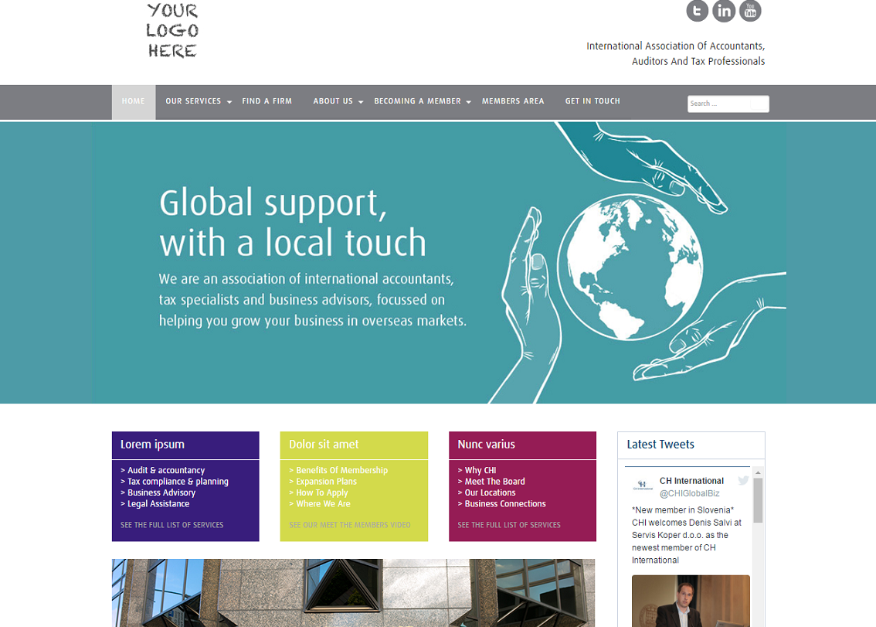
Marketing Committee Resolutions
HTML
web
template
Notes:
The committee thought a standard template that existing and new members could use would be useful – creating a consistent feel and also providing an almost ready made solution to members looking to improve their web presence.

Slide 6
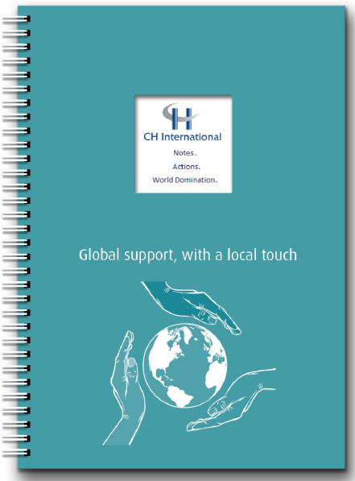
Marketing Committee
Promotional note pads
Notes:
As you will have seen, you each have a promotional pad to use back at your offices.
You’ll see that there is some promotional information about CHI in the front. The idea behind this is that it can act as discussion pointers in client meetings, where appropriate.
The information covers our goals, values and types of issues clients could be facing when considering trading abroad.
There is also a handy member country and contact details list.
There is an opportunity to have some of these notepads printed to give to your clients or staff if you’d like. Costs start at £7.35 each, (plus shipping) but go down if we order more than 100 pads. Alberto and I will be ordering some so please let Claire know if you’d also like to.

Slide 7
Marketing Committee
Members map board
Notes:
Clarkson Hyde have been looking at how they could raise awareness of CH International among their colleagues and clients and started to think about a magnetic board for their reception.
The idea being that new members can be added without having to replace the whole board

Slide 8
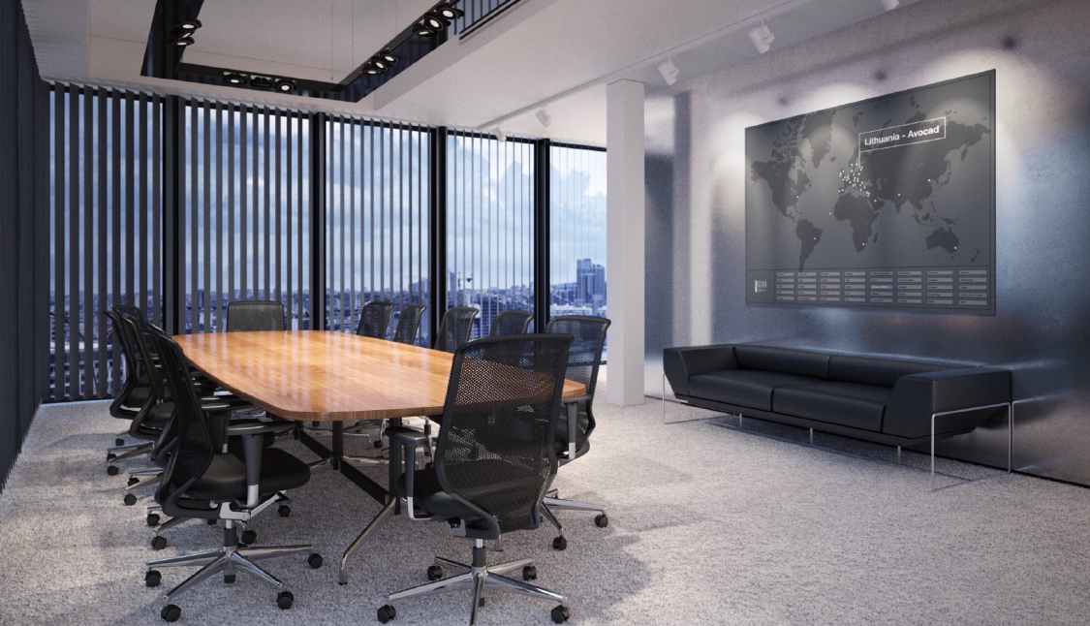
Notes:
At that time, by coincidence, one of the Cicero members got in touch to share a magnetic board they had made, as seen here.
The Cicero member (from Lithuania) have said that this is getting a lot of interest from clients and many questions are being asked about the Cicero members.

Slide 9
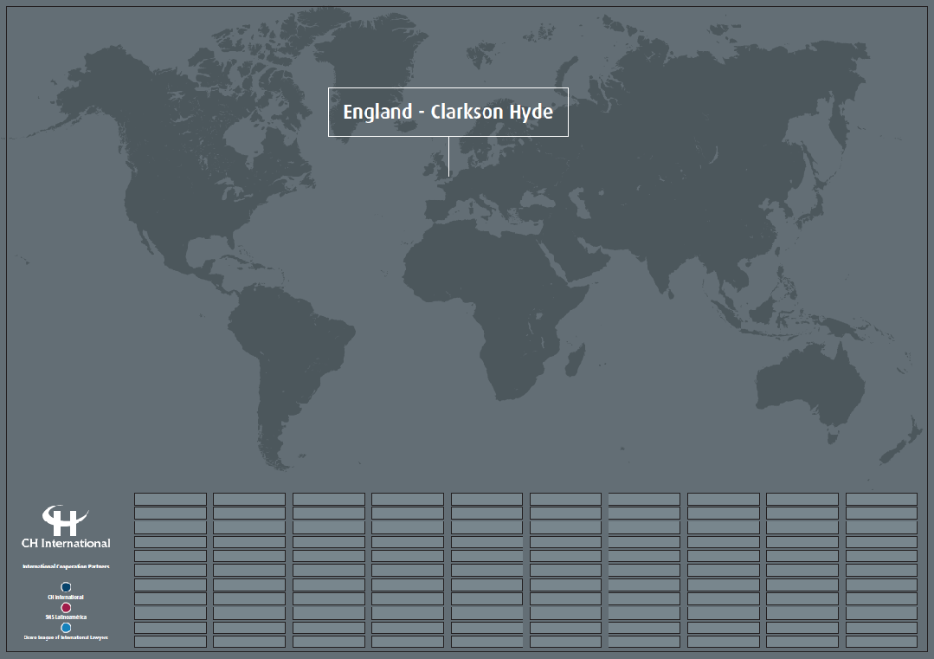
Notes:
The board thought this could be a great option for other members and so have pleasure in sharing this artwork.
If you are interested in having the board made, let Claire know. Again, the cost per board reduces the more people order, but starts at around £700 plus shipping per board, reducing to around £400 plus shipping if 10 or more are ordered.
This is for a size 118cm x 85cm board, including all magnetic markers.

Slide 10
Regional Groups
Asian Pacific Group
Cheng & Cheng hosted this years Asian pacific group on September 1st 2016.
Attendees from Australia, Malaysia, Singapore and myself!
Agenda items
2017 meeting in Australia
Notes:
Agenda items to be added here – update with feedback

Slide 11
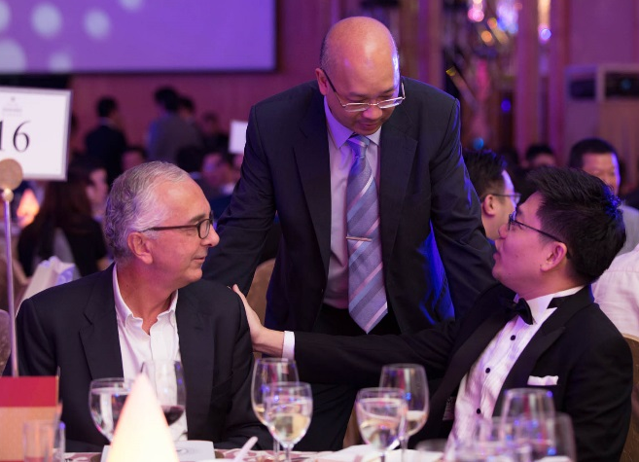
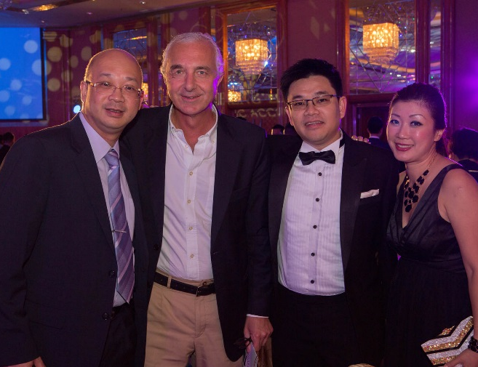
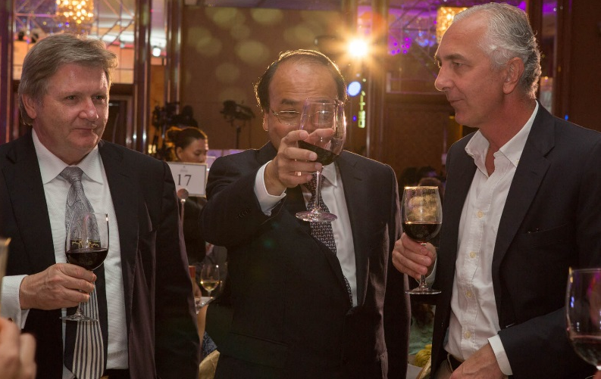

Slide 12
Co-operation with SMS Latin America
Formal cooperation with SMS Latin America
We have permission to show their counties on CHI’s website etc
SMS conference in Bolivia 28^{th-}30th September
Notes:
Press coverage in Spain
Did anyone else use the press release?
SMS made a referral to Beat in Switzerland and Cornelia in Germany but it unfortunately did not go ahead.
They also recently made a referral to us in Spain….

Slide 13
Cicero League of International Lawyers
Next conference: Madrid in November
Look at conference speaking opportunities
Continuing to share marketing and business ideas
Helping each other with new member introductions
Continue with referrals between Cicero & CHI and continue building relationships
Notes:
Continue with referrals between both networks.
Lets help them try and get a new member from their target countries.
We have introduced them to SMS Latin America
Thank you to those members who have helped them with their target countries so far.
We are pleased to tell you that last week our newest member, Denis Salvi recommended a law firm in Slovenia to Cicero.
Peter Munday has already been in contact with the company and we hope they can secure them as a new member for Cicero…..thank you Denis.

Slide 14
Thank you for listening ☺

